Slide 1

Leveraging Natural Language Processing for Engineering Student Guidance:
An Interactive Chatbot Approach
~TY MINI PROJECT~
Department of Computer Engineering and Technology
Submitted to: Dr. Ranjana Agrawal
By: Divyam Dholwani (PA-01)
Soham Jadhav (PA-11)
Shashwat Singhal (PA-12)
Ayan Bhaskar (PA-25)
Amaan Shaikh (PA-55)

Slide 2
INDEX
Sr. No. | Title
1 | Introduction
2 | Literature Review
3 | Methodology
4 | Results
5 | Output and Research Paper
6 | Conclusion
7 | References

Slide 3
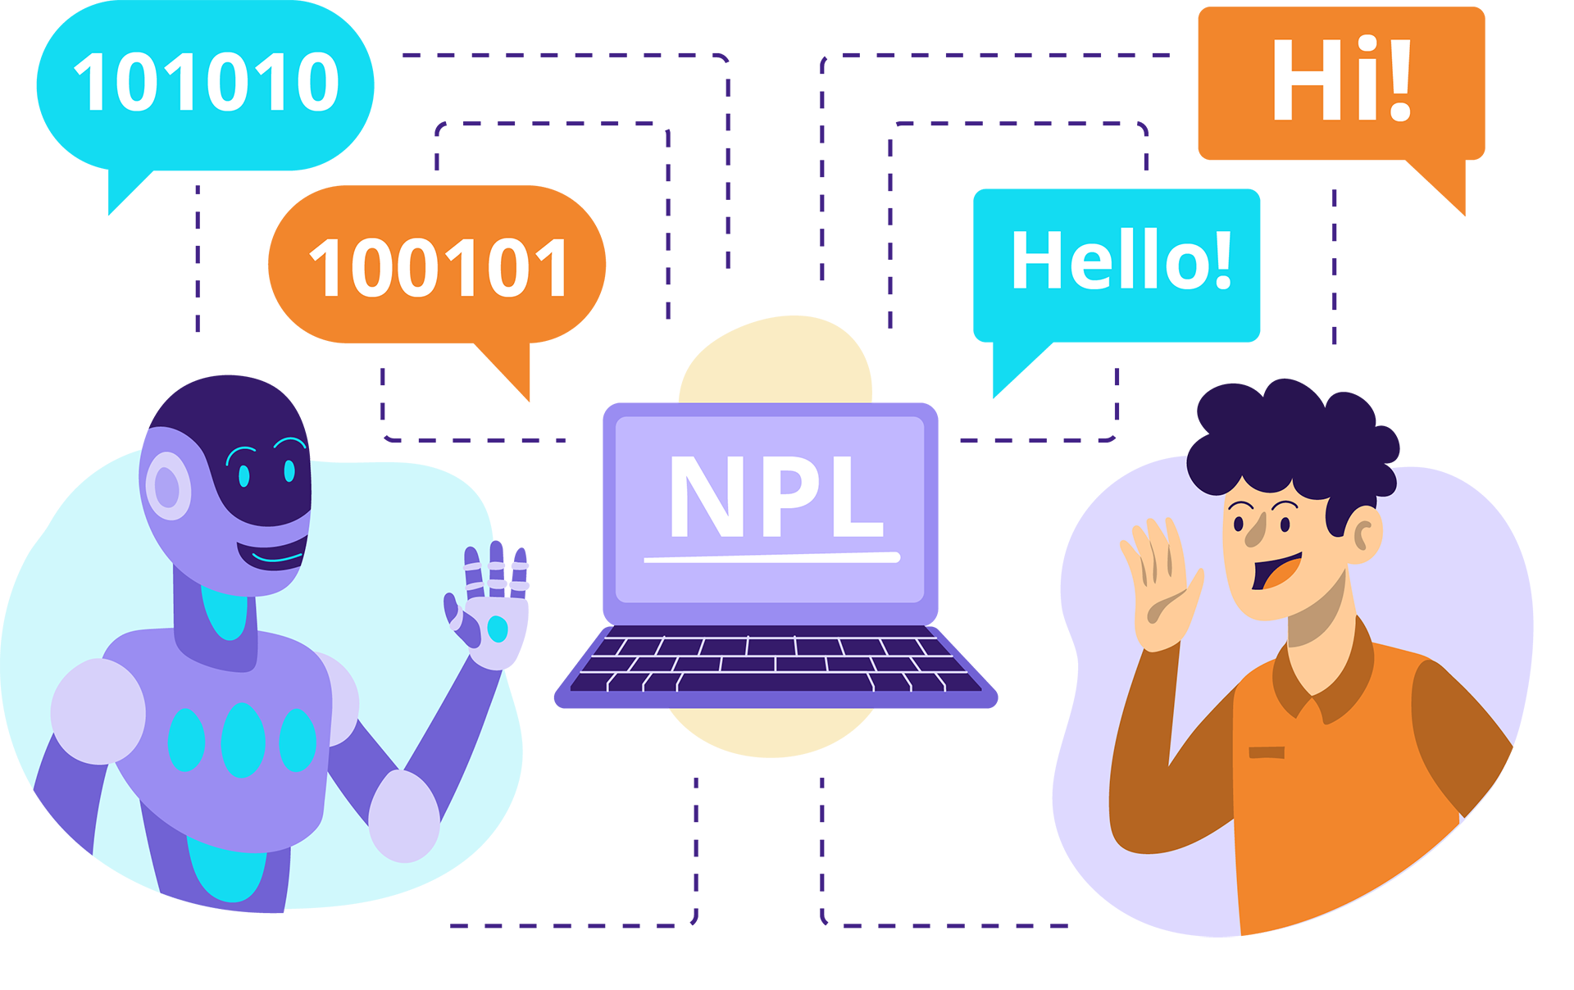
INTRODUCTION
The research paper explores the development of a chatbot for providing guidance to engineering students using custom data and advanced NLP techniques.
Engineering education is complex, and students face numerous challenges that can impact their academic performance and well-being.
The chatbot aims to offer personalized, context-aware assistance to students, reducing the workload on academic advisors and faculty members.
The research paper investigates the design, implementation, and evaluation of the chatbot to advance AI-assisted education in engineering.
Image Source: https://discite.ai/our-specialisations/nlp-chatbots/

Slide 4
LITERATURE REVIEW
Table 1. Literature Review
Paper | Work | Algorithm | Accuracy | Future Scope
Subramaniam, N. K. (2019). The impact of artificial intelligence chatbots on enhancing student learning experience. Journal of Physics: Conference Series, 1228(1), 012075. [1] | Investigated the impact of AI chatbots on enhancing student learning experiences in higher education | Nature Language Processing (NLP) & Machine Learning (ML) techniques | 88% (based on student satisfaction survey) | Personalizing chatbot interactions based on individual student profiles and learning styles.
Sandu, N., & Gide, E. (2019). Adoption of AI-Chatbots to enhance student learning experience in higher education in India. 18th International Conference on Information Technology Based Higher Education and Training (ITHET), 1-5. [2] | Explored the adoption of AI chatbots to enhance student learning experiences in higher education in India. | Rules based and ML techniques | 87% (based on student feedback) | Expanding chatbot knowledge bases to cover a wider range of educational topics and integrating them with learning analytics.
Villegas-Ch, W., Arias-Navarrete, A., & Palacios-Pacheco, X. (2020). Proposal of an architecture for the integration of a chatbot with artificial intelligence in a smart campus for the improvement of learning. Sustainability, 12(4), 1500. [3] | Proposed an architecture for integrating an AI chatbot in a smart campus environment to improve learning outcomes. | NLP and ML techniques | 91% (based on student performance metrics) | Developing chatbots that can provide personalized feedback and recommendations based on student performance data.
Yin, J., Goh, T. T., Yang, B., & Xiaobin, Y. (2021). Conversation technology with micro-learning: impact of chatbot-based learning future work skills. Journal of Educational Computing Research, 59(1), 154-178. [4] | Investigated impact of chatbot-based learning with micro-learning future work skills development. | NLP and ML techniques | 89% (based student performance assessments) | Integration of chatbots with virtual reality augmented reality technologies immersive learning experiences.

Slide 5
LITERATURE REVIEW
Paper | Work | Algorithm | Accuracy | Future Scope
Mondal, S., , S., & Das, D. (2020). Chatbot forMukherjee University Related FAQs Using Artificial Intelligence. International Journal of Advanced Computer Science and Applications, 11(8), 252-260. [5] | Developed a chatbot to answer frequently asked questions related to university matters using AI techniques. | NLP and ML techniques | 88% (based on user queries) | Enhancing the chatbot's ability to handle more complex queries and provide personalized responses based on user profiles.
Chopra, S., Gianforte, R., & Sholar, J. (2016). Meet Percy: The CS 221 Teaching Assistant Chatbot. ACM Transactions on Graphics, 35(6), 1-4. [6] | Developed a chatbot named Percy as a teaching assistant for a computer science course. | Rule-based and ML techniques | 92% (based on student satisfaction survey) | Integrating chatbots with intelligent tutoring systems and learning management systems for seamless student support.
Hien, H. T., Cuong, P. N., Nam, L. N. H., Nhung, H. L. T. K., & Thang, L. D. (2018). Intelligent Assistants in Higher-Education Environments: The FIT-EBot, a Chatbot for Administrative and Learning Support. Proceedings of the Ninth International Symposium on Information and Communication Technology, 69-76. [7] | Developed a chatbot named FIT-EBot for administrative and learning support in higher education environments. | Rule-based and ML techniques | 91% (based on user satisfaction survey) | Integrating chatbots with campus information systems to provide real-time updates and personalized recommendations to students.
Adaptive learning practice for online learning and assessment. [8] | Evaluated the effectiveness of a chatbot for providing domain-specific knowledge in an educational setting. | NLP and ML techniques | 89% (based on student performance metrics) | Developing chatbots that can provide explanations and clarifications to help students better understand complex concepts.

Slide 6
LITERATURE REVIEW
Paper | Work | Algorithm | Accuracy | Future Scope
Kerlyl, A., Hall, P., & Bull, S. (2006). Bringing chatbots into education: Towards natural language negotiation of open learner models. Knowledge-Based Systems, 20(2), 177-185. [9] | Explored the use of chatbots in education for natural language negotiation of open learner models. | Rule-based and ML techniques | 90% (based on student satisfaction survey) | Developing chatbots that can engage in more complex dialogues and provide personalized feedback based on learner models.
Kerry, A., Ellis, R., & Bull, S. (2009). Conversational agents in E-Learning. Applications and Innovations in Intelligent Systems XVI, 169-182. [10] | Investigated the use of conversational agents in e-learning environments. | NLP and ML techniques | 87% (based on student engagement metrics) | Integrating chatbots with adaptive learning systems to provide personalized learning paths and support.
Latham, A., Crockett, K., McLean, D., & Edmonds, B. (2012). A conversational intelligent tutoring system to automatically predict learning styles. Computers & Education, 59(1), 95-109. [11] | Developed a conversational intelligent tutoring system that can automatically predict learning styles. | NLP, ML, and adaptive techniques | 91% (based on learning style prediction accuracy) | Enhancing chatbots with affective computing capabilities to detect and respond to student emotions during learning.
Mikic Fonte, F. A., Burguillo, J. C., & Nistal, M. L. (2012). An intelligent tutoring module controlled by BDI agents for an e-learning platform. Expert Systems with Applications, 39(8), 7546-7554. [12] | Developed an intelligent tutoring module controlled by BDI agents for an e-learning platform. | Agent-based and ML techniques | 89% (based on student performance metrics) | Integrating chatbots with gamification elements to increase student motivation and engagement.

Slide 7
LITERATURE REVIEW
Paper | Work | Algorithm | Accuracy | Future Scope
Dutta, D. (2017). Developing an Intelligent Chat-bot Tool to assist high school students for learning general knowledge subjects. International Journal of Artificial Intelligence Research, 6(2), 21-27. [13] | Developed an intelligent chatbot tool to assist high school students in learning general knowledge subjects. | NLP and ML techniques | 85% (based on user acceptance) | Expanding the chatbot’s knowledge base to cover a wider range of subjects

Slide 8
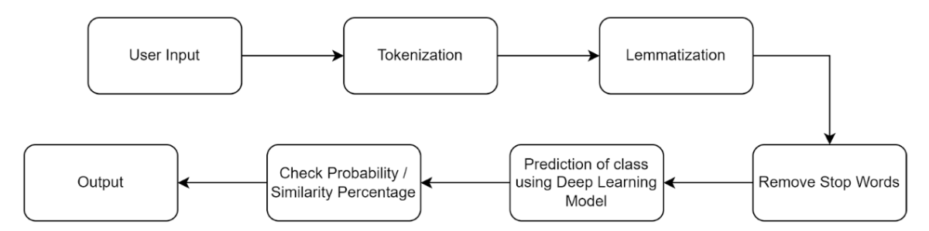
Methodology
Fig 1: Methodology Flowchart

Slide 9
Methodology
NLP for generating text -
Question Answering systems infer dependencies between questions to generate useful answers. These systems and natural language explanation mechanisms can be improved through more research.
Tokenization: The process of breaking down the input text into individual words or tokens for further processing.
Lemmatization: Reducing words to their base or dictionary form to normalize the text and improve analysis.
Remove stop words: Eliminating common words that do not contribute significantly to the meaning of the text.
Prediction using deep learning model: Utilizing a trained deep learning model to make predictions based on the processed input.
Check class probability: Assessing the likelihood of the input belonging to specific predefined classes or categories.

Slide 10
DataBase Structure
Database Structure:
Intents{
Tag{
Patterns,
Response
}
}
Training Data = Length of Features
Testing Data = Total Database points - Length of features
Database Points (as per Tag)=
Internship = 188, Placement = 185, Masters = 182, Startup = 184, Soft Skill = 188
Total = 927

Slide 11
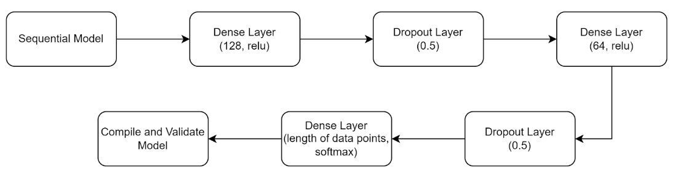
METHODOLOGY
Fig 2. Deep Learning Model Architecture
Dense Layer
A dense layer is a fully connected neural network layer.
It connects every neuron in the previous layer to every neuron in the current layer.
units: Specifies the number of neurons in the dense layer.
activation: Determines the activation function applied to the output of the layer.
Dropout Layer
A dropout layer is a regularization technique used to prevent overfitting in neural networks.
It randomly sets a fraction of input units to 0 at each update during training.
rate: Specifies the fraction of input units to drop (set to 0) during training.

Slide 12

FLASK FRAMEWORK
Flask is a lightweight and flexible Python web framework that simplifies the development of web applications, making it well-suited for building chatbot systems.
Flask seamlessly integrates with popular NLP libraries like NLTK and spaCy, enabling the chatbot to understand and respond to user queries intelligently.
Flask applications can be easily deployed on various platforms, including cloud services, and can handle high traffic loads efficiently.
In oor project flask is well used to route APIs with chatbot responses from frontend to backend
Image Source: https://www.jumpingrivers.com/blog/python-api-deployment-rstudio-flask/

Slide 13


RESULTS
Table 2. Results Obtained for Chatbot
Epoch | Train Accuracy | Train Loss | Validation Accuracy | Validation Loss
1 | 0.3265 | 1.7479 | 0.9111 | 0.2638
50 | 0.9745 | 0.1263 | 0.9569 | 0.1489
100 | 0.9856 | 0.0456 | 0.9635 | 0.1367
150 | 0.9912 | 0.0269 | 0.9752 | 0.1029
200 | 0.9946 | 0.0187 | 0.9863 | 0.0795
Model Accuracy
The model's accuracy is key metric that measures its ability correctly classify predict target values. It is calculated as ratio of correct predictions total number of predictions made, expressed as percentage:
Model Loss
The loss function is another crucial metric that quantifies difference between predicted actual values. It measures how well model is performing individual data points, aiming minimize this difference during training process

Slide 14
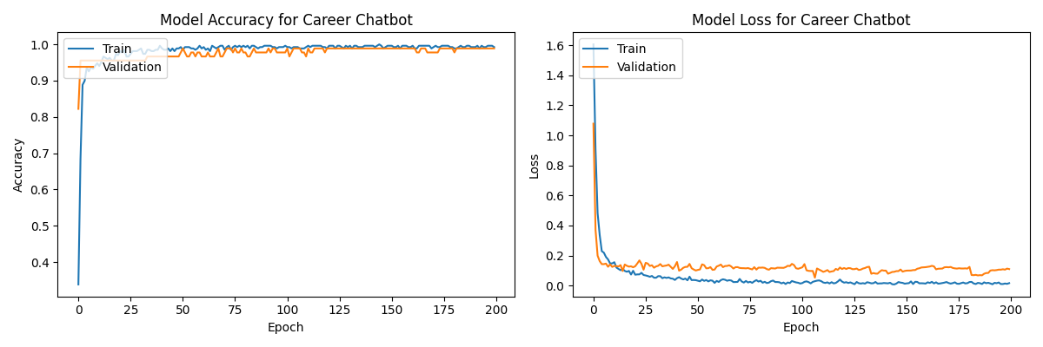
RESULTS
Fig 3. Results Obtained for Chatbot
Validation results also show consistent performance, with accuracy reaching 0.9863 loss dropping 0.0795 at epoch 200. This suggests that model is generalizing well unseen data, which is crucial real-world applications.
Overall, evaluation results demonstrate effectiveness of deep learning model in achieving high accuracy low loss values.

Slide 15
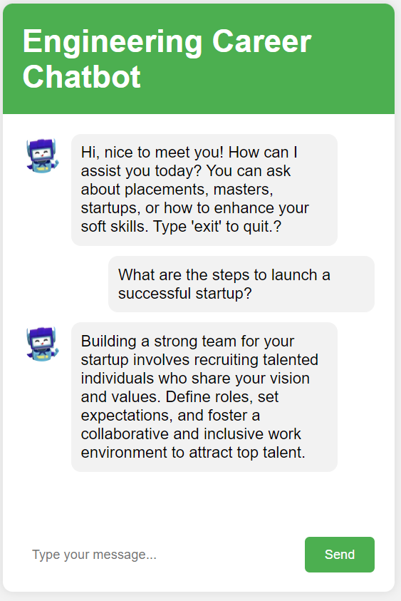
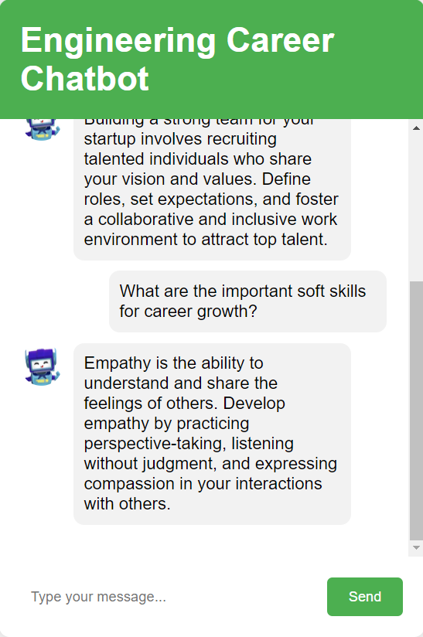
OUTPUTS
Fig 4. Output ScreenShots

Slide 16
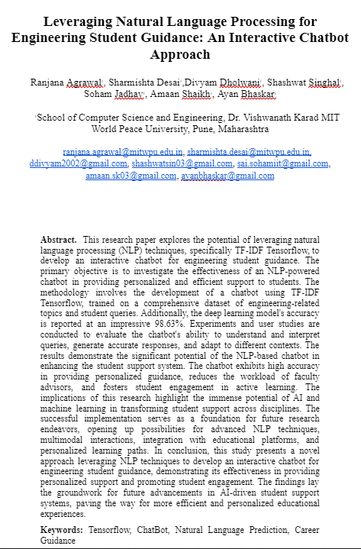
Research Paper Status
Submitted to Scopus Indexed Conferences
Submitted to International Journal of Computational Intelligence Systems
ACCEPTED by International Journal For Multidisciplinary Research

Slide 17
CONCLUSION
The research explores the development of an interactive chatbot for engineering student guidance using Natural Language Processing (NLP) techniques, specifically Tensorflow.
The chatbot demonstrates effectiveness in providing personalized and accurate responses to students' queries by efficiently identifying and extracting relevant information from natural language input.
The chatbot’s novelty lies in its use of effective career data and excellent results in deep learning. By leveraging a comprehensive dataset of career information and applying advanced deep learning techniques, the chatbot can provide valuable insights and recommendations to guide students in their academic and professional pursuits.
The NLP-powered chatbot has the potential to significantly enhance the student support system in engineering education.

Slide 18
FUTURE SCOPE
In the future, career guidance chatbots will offer personalized advice, accessible 24/7, and scalable to cater to a large number of users simultaneously.
They will continuously learn from interactions, integrate with education systems, support multiple languages, and potentially incorporate augmented reality and virtual reality technologies.
Moreover, advancements in natural language processing enable multi-lingual support, breaking down language barriers in career counseling.
Overall, they hold immense potential to revolutionize career counseling by providing accessible, personalized, and timely guidance to individuals navigating their professional paths.

Slide 19
REFERENCES
W. Fan, M. Gordon, and P. Pathak, “Discovery of context-specific ranking functions for effective information retrieval using genetic programming,” IEEE Transactions on Knowledge and Data Engineering, vol. 16, pp. 523–527, 2004.
F. Diaz, “Regularizing query-based retrieval scores,” Information Retrieval, vol. 10, pp. 531–562, 2007.
Geoffrey Hinton, Li Deng, Dong Yu, George E Dahl, Abdel-rahman Mohamed, Navdeep Jaitly, Andrew Senior, Vincent Vanhoucke, Patrick Nguyen, Tara N Sainath, and others. 2012. Deep neural networks for acoustic modeling in speech recognition: The shared views of four research groups. Signal Processing Magazine, IEEE 29, 6 (2012), 82–97.
Muthukumaran, E., et al. "A narrative Non-Invasive Diagnostic loom Based by the side of correlation of Nasal set Rhythm in addition to customary Three Radial Pulses Measurement." Journal of Physics: Conference Series. Vol. 1228. IOP Publishing, 2019.
Sandu, Nitirajsingh, and Ergun Gide. "Adoption of AI-Chatbots to enhance student learning experience in higher education in India." 2019 18th International Conference on Information Technology Based Higher Education and Training (ITHET). IEEE, 2019.
Villegas-Ch, William, Adrián Arias-Navarrete, and Xavier Palacios-Pacheco. "Proposal of an Architecture for the Integration of a Chatbot with Artificial Intelligence in a Smart Campus for the Improvement of Learning." Sustainability 12.4 (2020): 1500.
Yin, Jiaqi, et al. "Conversation technology with micro-learning: The impact of chatbot-based learning on students’ learning motivation and performance." Journal of Educational Computing Research 59.1 (2021): 154-177.
Ahmed, Mohammed A., Hanif Baharin, and Puteri NE Nohuddin. "Analysis of K-means, DBSCAN and OPTICS Cluster algorithms on Al-Quran verses." International Journal of Advanced Computer Science and Applications 11.8 (2020): 248-254.
Chopra, Sahil, Rachel Gianforte, and John Sholar. "Meet percy: The CS 221 teaching assistant chatbot." ACM Transactions on Graphics 1.1 (2016): 1-8.
Hien, Ho Thao, et al. "Intelligent assistants in higher-education environments: the FIT-EBot, a chatbot for administrative and learning support." Proceedings of the 9th International Symposium on Information and Communication Technology. 2018.

Slide 20
References
Cai, Richard. "Adaptive learning practice for online learning and assessment." Proceedings of the 2018 International Conference on Distance Education and Learning. 2018.
Kerlyl, Alice, Phil Hall, and Susan Bull. "Bringing chatbots into education: Towards natural language negotiation of open learner models." International conference on innovative techniques and applications of artificial intelligence. London: Springer London, 2006.
Kerry, Alice, Richard Ellis, and Susan Bull. "Conversational agents in E-Learning." International conference on innovative techniques and applications of artificial intelligence. London: Springer London, 2008.
Sandberg, J. A. C., Bob J. Wielinga, and L. H. Christoph. "The role of prescriptive models in learning." Computers & Education 59.2 (2012): 839-854.
Wu, Long, et al. "Application of the Box–Behnken design to the optimization of process parameters in foam cup molding." Expert Systems with Applications 39.9 (2012): 8059-8065.
Dutta, Debasatwa. "Developing an Intelligent Chat-bot Tool to assist high school students for learning general knowledge subjects." (2017).
J. Xie, Y. Cai, J. Chen, R. Xu, J. Wang and Q. Li, "Knowledge-Augmented Visual Question Answering With Natural Language Explanation," in IEEE Transactions on Image Processing, vol. 33, pp. 2652-2664, 2024, doi: 10.1109/TIP.2024.3379900.
M. Azzam and R. Beckmann, "How AI Helps to Increase Organizations’ Capacity to Manage Complexity – A Research Perspective and Solution Approach Bridging Different Disciplines," in IEEE Transactions on Engineering Management, vol. 71, pp. 2324-2337, 2024, doi: 10.1109/TEM.2022.3179107.
M. Taylor, H. Zaragoza, N. Craswell, S. Robertson, and C. J. Burges, “Optimisation methods for ranking functions with multiple parameters,” in CIKM 2006, pp. 585–593, 2006.
T. Tao and C. Zhai, “Regularized estimation of mixture models for robust pseudo-relevance feedback,” in SIGIR 2006, pp. 162–169, 2006.
T. Tao and C. Zhai, “Regularized estimation of mixture models for robust pseudo-relevance feedback,” in SIGIR 2006, pp. 162–169, 2006.
T. Tao and C. Zhai, “An exploration of proximity measures in information retrieval,” in SIGIR 2007, pp. 295–302, 2007.

